Slide 1

ΕΠΛ 434 –ΛΟΓΙΚΟΣ ΠΡΟΓΡΑΜΜΑΤΙΣΜΟΣ ΚΑΙ ΤΕΧΝΗΤΗ ΝΟΗΜΟΣΥΝΗ ΆΣΚΗΣΗ ΓΟΡΓΙΑ – ΜΕΡΟΣ 3 FOOD PICKER
- Από ομάδα 5 - Panikos Christou – Cristian Ionut Canciu

Slide 2


Panikos and Cristian
Panikos prefers:
Delivery
Takeaway
Cook
Cristian prefers:
Cook
Takeaway
Delivery

Slide 3
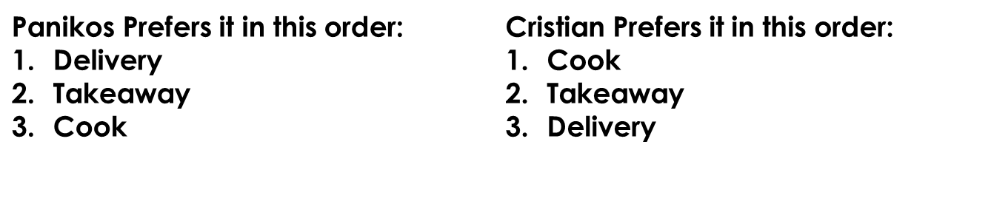
Natural language description:
We have 2 students who have different ways of getting their foods.
Firstly, there is a chance the restaurant does noDelivery or noTakeaway, moreover there is a chance we can’t cook (noCook) each contradicting all their respective options. Secondly, we can be in moodToCook so we cook despite for example preferring delivery . Thirdly, we can haveHw so we prefer delivery/takeaway depending on the User because University work is more important that time to cook.
Fourthly, there is a chance we have easyHw so we prefer to do what we wanted in the beginning and pretty much cancels the havehw part. Lastly, if all options are contradicted, then we are left with no option than to cook with anything we have.

Slide 4



Options
We have 3 options:
Delivery(method)
takeaway(method)
cook(method)

Slide 5
Contradictions:
noCook – We can not cook so we have not(cook(method))
noTakeaway – We can not takeaway, so we have not(takeAway(method))
noDelivery – We can not get a delivery, so we have not(delivery(method))
noOptions – If all the above options are true then we are left in a scenario where nothing happens, so we cook with everything we have.

Slide 6
Environment/Sensory information:
moodToCook/0 – We are in the mood to cook despite preferences
haveHw/0 – We have homework so we must either have a delivery or a takeaway
easyHw/0 – the homework is easy, so we cancel it

Slide 7
Scenarios
Panikos scenarios (the delivery lover)
delivery(method)> # we prefer delivery always
noDelivery} , takeAway(method)> # we prefer takeaway after delivery is unavailable
moodToCook}, cook(method)> # we prefer to cook
haveHw}, delivery(method)> # we prefer delivery than takeAway (Cristian does not)
haveHw,easyHw}, delivery (method)> # we can still cook, but prefer delivery (Cristian does not)
moodToCook, haveHw , easyHw }, cook(method)> # we can do anything so we prefer to cook
moodToCook, noCook}, delivery(method)> # we cannot cook so we go with delivery
haveHw, noDelivery}, takeAway(method)> # we cant delivey like above so takeaway instead
haveHw,easyHw, noDelivery, noTakeaway}, cook(method)> # we cook even if last resort
moodToCook, haveHw , easyHw, noCook }, delivery(method)> # we delivery because we cant cook
haveHw , noCook, noDelivery, noTakeaway}, cook(method) # we have no options so we are left to cook despite everything else.
haveHw , noCook, noDelivery, noTakeaway}, cook(method) # we have no options so we are left to cook despite everything else.

Slide 8
Scenarios
Cristian scenarios (the cooking lover)
cook(method)> # we prefer cooking always
noCook} , takeAway(method)> # we prefer takeaway after cooking is unavailable
moodToCook}, cook(method)> # we prefer to cook
haveHw}, takeAway(method)> # we prefer takeAway than delivery (Panikos does not)
haveHw,easyHw}, cook(method)> # we can still cook,so we do (Panikos does not)
moodToCook, haveHw , easyHw }, cook(method)> # we can do anything so we prefer to cook anyways
moodToCook, noCook}, takeAway(method)> # we cannot cook so we go with takeaway
haveHw, noTakeaway}, delivey(method)> # we can’t takeaway like we like so we delivery instead
haveHw, easyHw, noDelivery, noTakeaway}, cook(method)> # we cook because nothing else is allowed
moodToCook, haveHw , easyHw, noCook }, takeAway(method)> # we takeaway because we cant cook like we like
haveHw , noCook, noDelivery, noTakeaway}, cook(method) # we have no options so we are left to cook despite everything else.

Slide 9
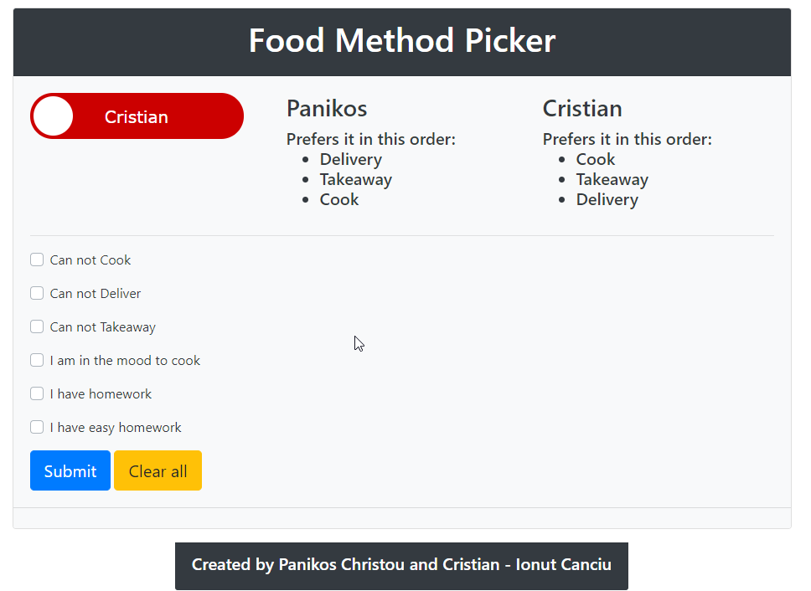
Website:
We a switch on top indicating which User we prefer. And below we have checkboxes for the arguments.

Slide 10
Architecture:

Slide 11
Demo video :

